Slide 1
Machine Learning Predicts Supreme Court Decisions
By Arpit Jasapara
Original paper by Daniel Martin Katz , Michael J. Bommarito II, Josh Blackman

Slide 2
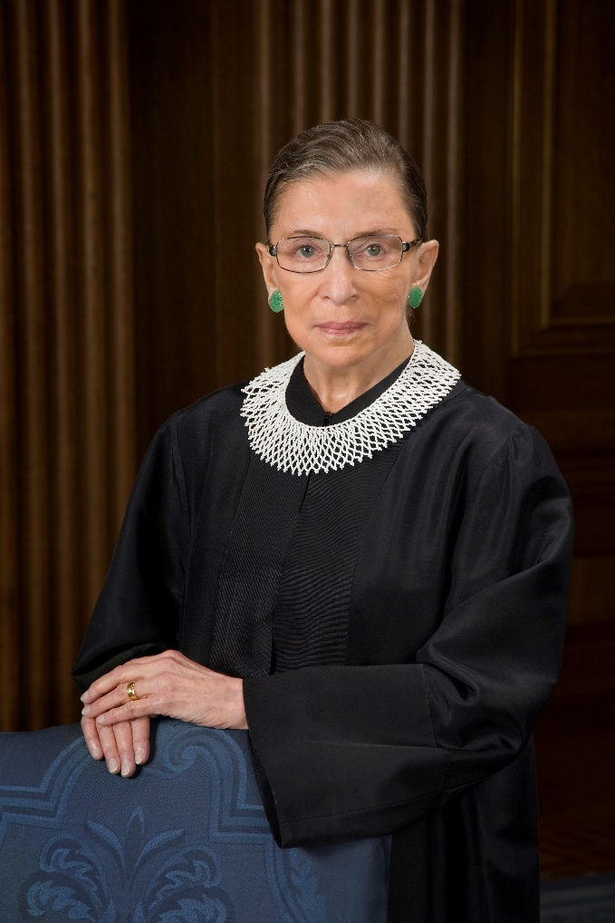
Supreme Court of the United States
9 Justices
Serve Average of 20 years
Deliver in-depth decisions for over 100 cases per year
Majority, Concurring, Dissenting Opinions
That gives data for 2000 decisions per Justice!

Slide 3
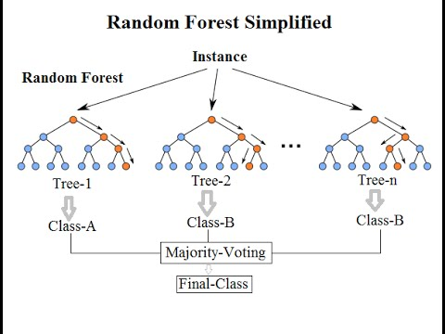
Machine Learning Model
Random Forest: Creates Regression of Trees to Predict Average Tree/General Behavior
Adds new tree per decision
Selects which tree to keep in model through grid-searching, split criterion, heuristic
Changes only upon addition of court justices

Slide 4
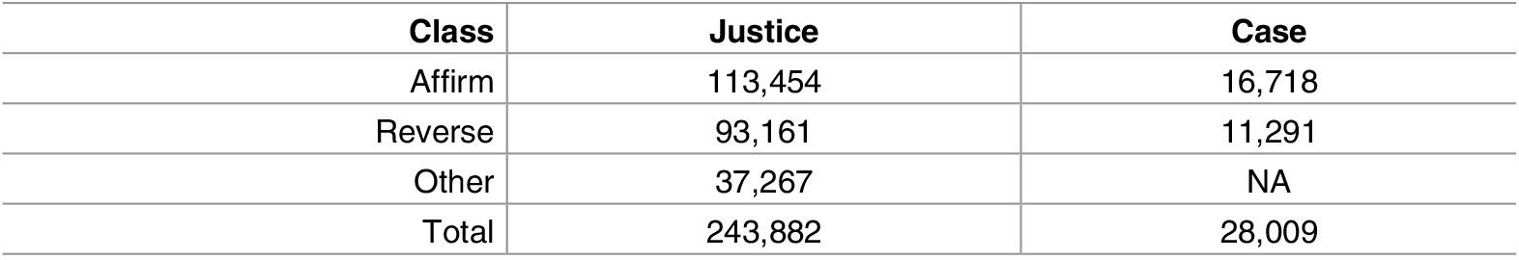
Data Collection
SCDB (Supreme Court Database)
Justice Disposition Divided into 3 Categories:
Affirm
Reverse
Other
Case Outcome based on Majority of Justices’ Decision
Features to Summarize Behavior of Justice

Slide 5
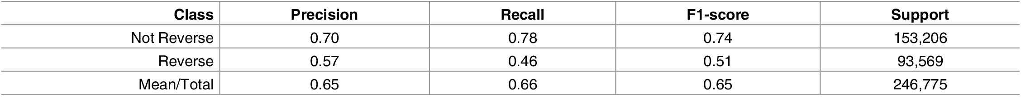
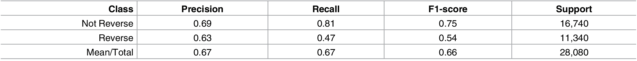
Results: Standalone
Surprisingly Accurate: Most Current Models to Predict Supreme Court are no better than 50%
Results for Individual Justice Decisions:
Results for Overall Case Outcome:
Notes:
Precision = ratio of correct to correct and false positives
Recall = ratio of correct to correct and false negatives

Slide 6
Results: Three Baseline Models
Always Guess Reverse
Infinite Memory
Optimized Finite Memory Model

Slide 7
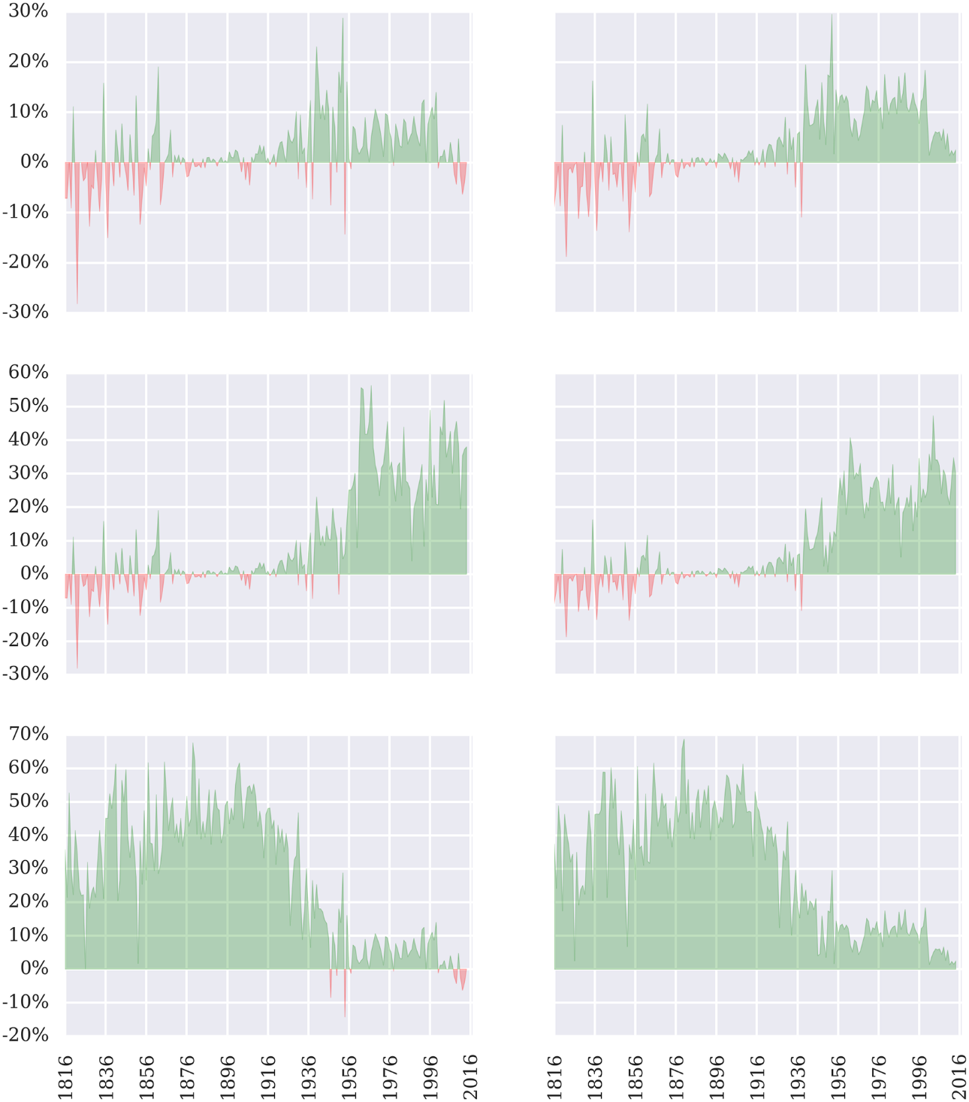
Always Guess Reverse
Historically, Supreme Court reverses Decision
Graph demonstrates Machine Learning Model Performance compared to Baseline
Green means the Machine Learning Model performed better, Left is Case Outcome and Right is Justices’ Outcome

Slide 8
Infinite Memory
Average out Decisions since Beginning of Supreme Court
MLM Better at Predicting Modern Years than Earlier Years

Slide 9
Optimized Finite Memory Model
Use finite window around case to determine outcome

Slide 10
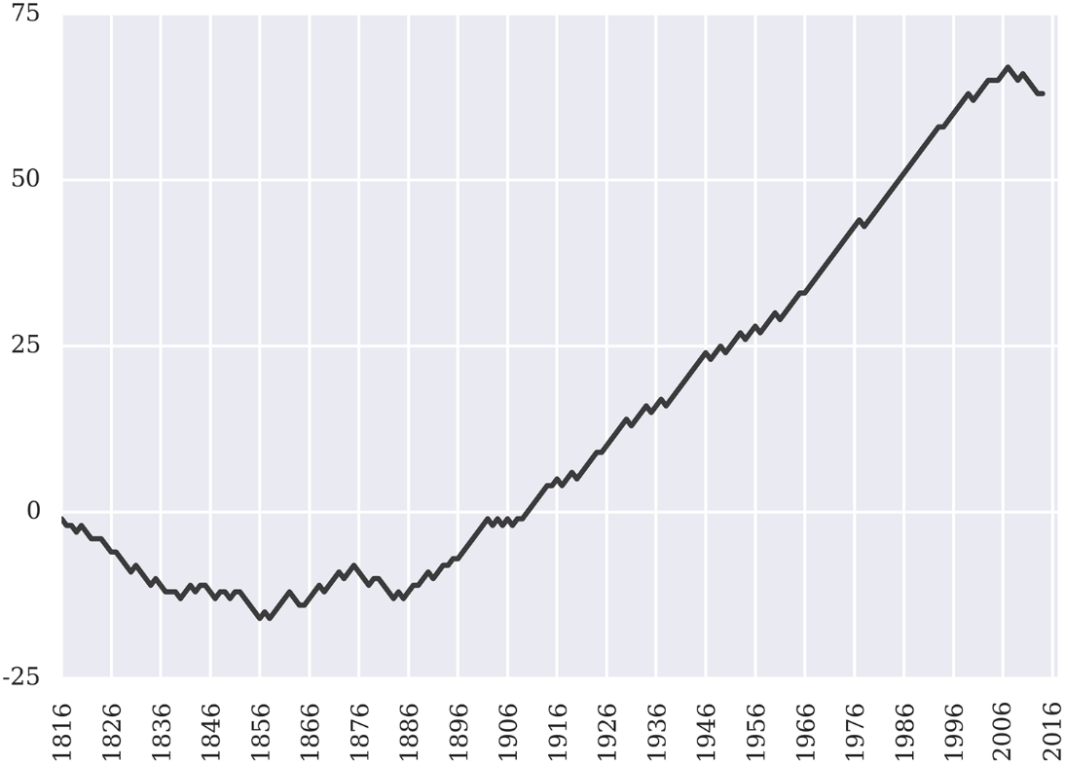
Consistency, Accuracy, Generality
Consistency: Same Results Every Time
Accuracy: Close to Real Outcome
Generality: Works No Matter Who is on Supreme Court

Slide 11
Out-of-Sample Applicability
All information required for model needs to be known beforehand
Model can be exported to other law problems:
Jury Selection
Negotiating Plea Deals
Doesn’t have to be just law problems:
Predict Referee Decisions in Sports
American Idol finalists, Miss Universe, and other entertainment judging
Market/Public Reaction to Policy and Decisions

Slide 12
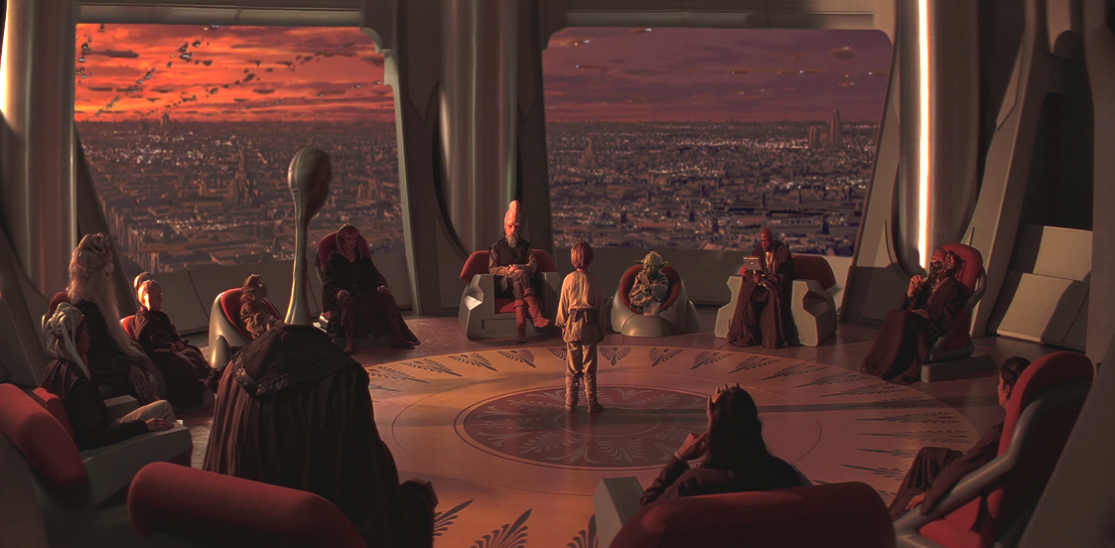
Conclusion
Relatively Accurate Model
Works well with Predicting Past Cases
Future:
Adapt model to take in more inputs to allow for prediction of future cases
Sell model to both parties, so best arguments are put forth
Increase accuracy
The future will rely on such machine learning models to use blend of experts, crowds, and algorithms to create accurate predictions

Slide 13
References
Hutson, Matthew. "Artificial intelligence prevails at predicting Supreme Court decisions." Science Magazine. N.p., 2 May 2017. Web. 29 May 2017. <http://www.sciencemag.org/news/2017/05/artificial-intelligence-prevails-predicting-supreme-court-decisions>.
Katz DM, Bommarito MJ II, Blackman J (2017) A general approach for predicting the behavior of the Supreme Court of the United States. PLoS ONE 12(4): e0174698. <https://doi.org/10.1371/journal.pone.0174698>.
Kumar, Niraj. Random Forest Algorithm. Digital image. LinkedIn. N.p., 17 June 2016. Web. 29 May 2017. <https://www.linkedin.com/pulse/random-forest-algorithm-interactive-discussion-niraj-kumar>.
"AI Prevails at Predicting Supreme Court Decisions." ACM TechNews. 5 May 2017. Web. 29 May 2017. <http://technews.acm.org/archives.cfm?fo=2017-05-may/may-05-2017.html>.

